Slide 1
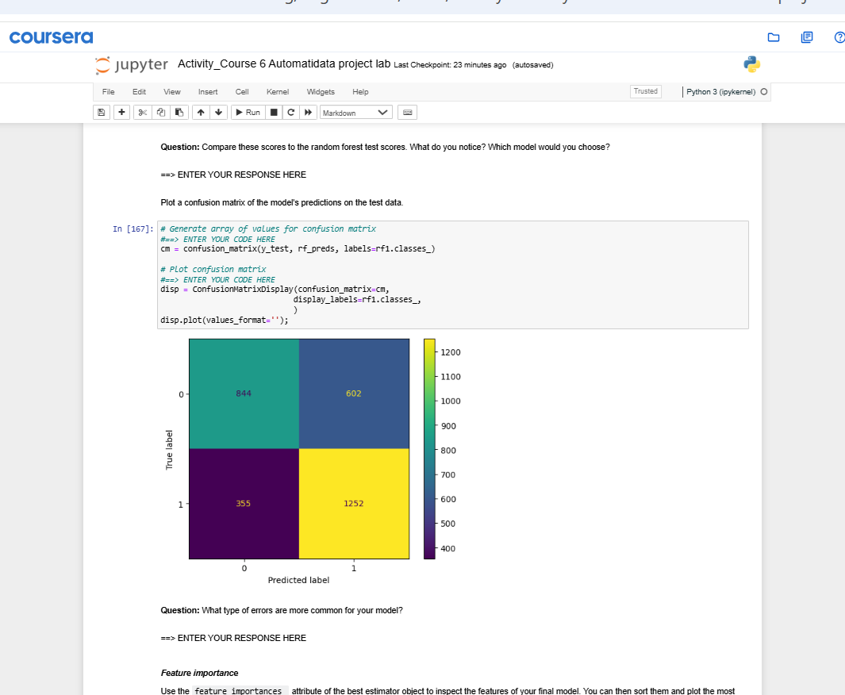
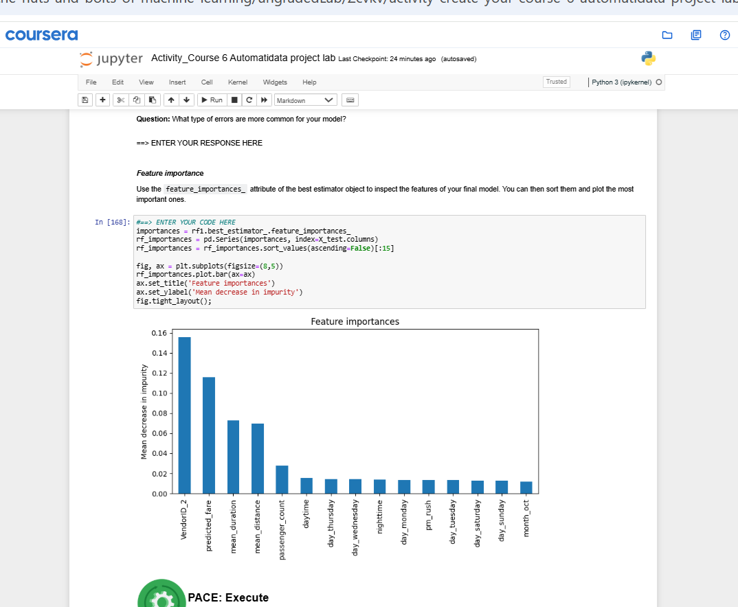
Title
Subtitle
The primary goal was to explore if machine learning could identify factors associated with generous tipping (defined as >=20%) among NYC taxi riders using the provided 2017 TLC dataset. However, a major challenge identified early on was the significant data limitation: reliable tip information was only available for credit card transactions, meaning any model built would inherently be biased and unable to represent tipping behavior for customers paying with cash.
To address the objective within the data constraints, we filtered the dataset for credit card payments only, engineered relevant features (including time-based categories like day/month/time-of-day, tip percentage, and the binary 'generous' target variable), and removed features prone to data leakage. We then built and tuned two classification models, Random Forest and XGBoost, using 5-fold cross-validation with GridSearchCV, optimizing primarily for the F1-score to balance precision and recall.
Image Alt-Text Here
Both models demonstrated a reasonable ability to learn patterns from the credit card tip data, achieving F1-scores around 0.70-0.72 on the test set, with Random Forest performing slightly better [cite: Nuts 18.png, Nuts 20.png]. This demonstrates the technical feasibility of applying these models. However, the most significant impact is understanding the model's limitations: due to the fundamental bias of the input data, the model's predictions cannot be reliably generalized to the entire rider population (including cash tippers) and should not be used for operational deployment that affects customers or drivers.
Image Alt-Text Here
Key insights include:
Machine learning models could achieve moderate success (F1 ~0.72) in predicting credit card tipping behavior based on available features.
2) Factors like VendorID, predicted_fare, average trip duration/distance, and passenger_count were the strongest predictors in the Random Forest model [cite: Nuts 22.png].
3) The model was more prone to predicting a generous tip when one wasn't given (False Positives) than missing an actual generous tip (False Negatives) [cite: Nuts 21.png].
4) The most critical insight for stakeholders is that conclusions are strictly limited to credit card tips due to data bias, preventing reliable generalization or ethical deployment.

